Slide 1

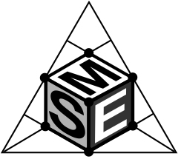
P13 – Lviv Polytechnic National University
Applied materials science and materials engineering
Zoia Duriagina

Slide 2



University: facts and figures
Founded in 1844, it is the oldest technical university in Eastern Europe
More than 35000 students (45% Bachelors, 35% Masters, 9% on the Doctoral program and others) and 600 postgraduates in 2013-2014
There are over 2300 staff members, 250 of whom are professors (holding a Dr. of Sc. Degree) and over 1100 – associate professors (Doctors of Philosophy)
Member of International networks:
Among 275 establishments of higher education in Ukraine
Among 311 establishments of higher education in Ukraine
Among 232 establishments of higher education in Ukraine

Slide 3
University: facts and figures
Lviv Polytechnic National University is a member of the following international organizations:
Magna Charta Universitatum;
European University Association (EUA);
Alliance of Universities for Democracy (AUDEM);
Association of the Carpathian Region Universities (ACRU);
Board of European Students of Technology (BEST);
Association des Etats Generaux des Etudiants
de I’Europe/European Students’ Forum (AEGEE).

Slide 4
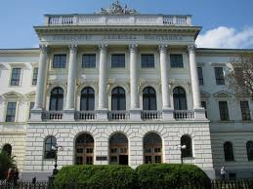
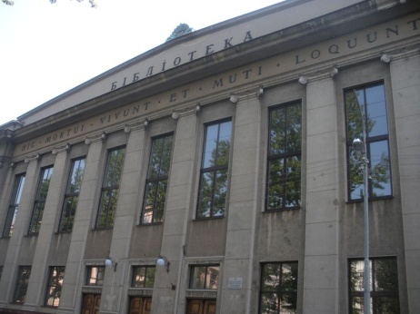
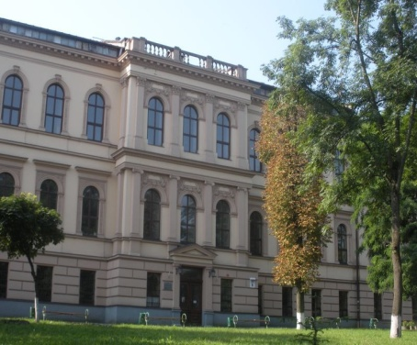
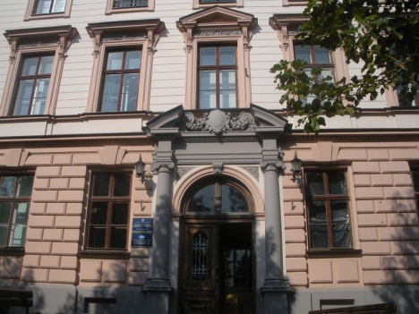
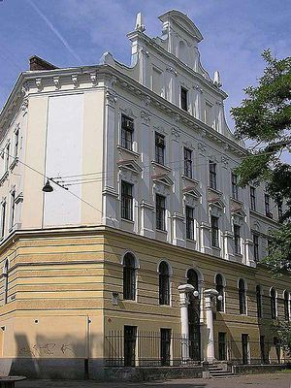
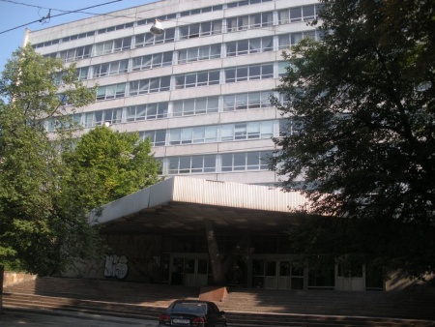
University structure
The University comprises 16 educational and research
institutes with 104 academic departments:
Institute of Geodesy
Institute of Humanities and Social Sciences
Institute of Economics and Management
Institute of Power Engineering and Control Systems
Institute of Engineering Mechanics and Transport
Institute of Computer Sciences and Information Technology
Institute of Computer Technologies, Automation and Metrology
Institute of Architecture
Institute of Business and Technology Policy
Institute of Applied Mathematics and Basic Sciences
Institute of Telecommunications, Radioelectronics and
Electronic Engineering
Institute of Ecology of Nature Protection and Tourism
Institute of Chemistry and Chemical Technology

Slide 5
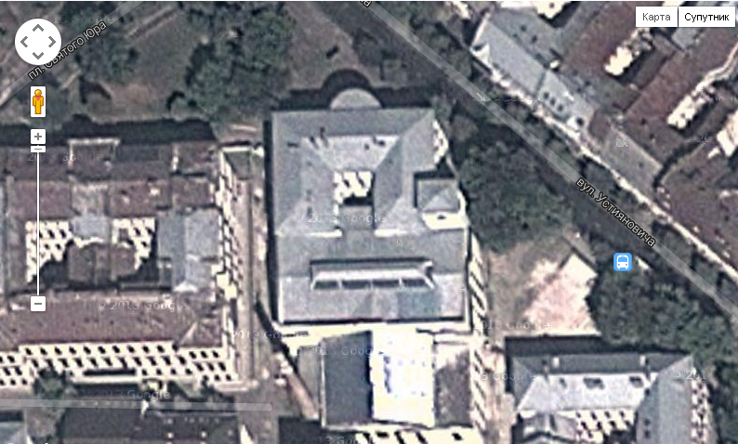
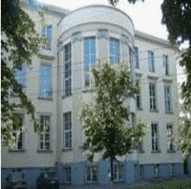
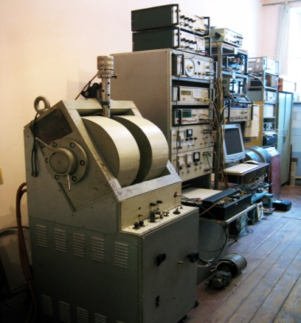
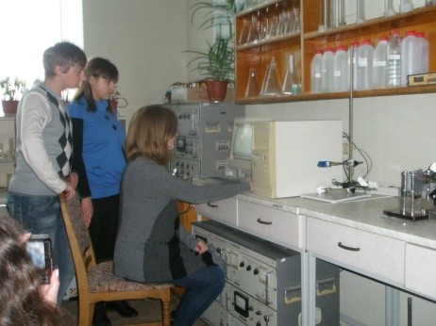
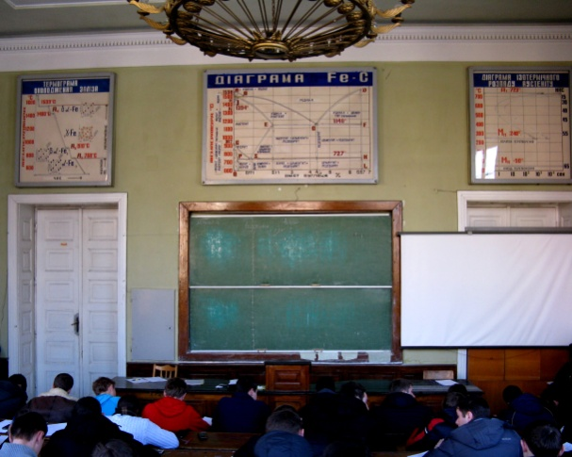
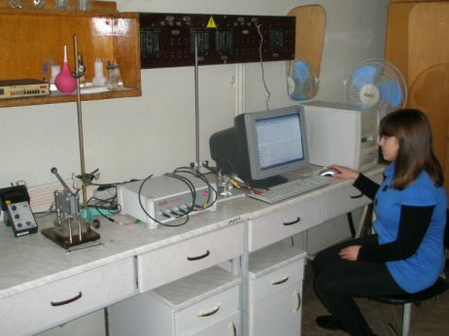
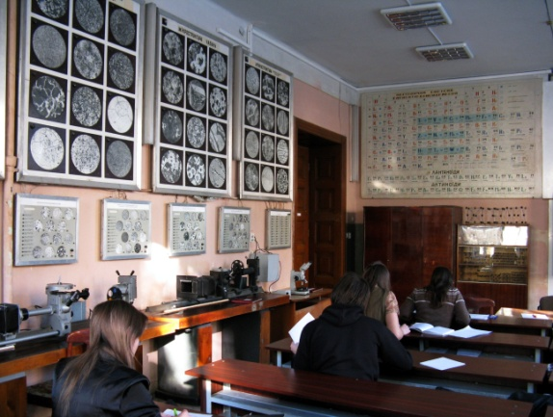
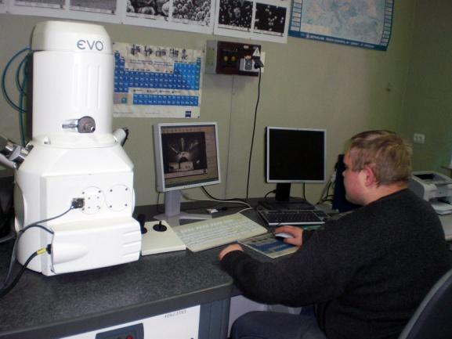
Department of applied materials science and materials engineering

Slide 6
Department of applied materials science and materials engineering
Research interests of the department consist in:
Surface engineering: laser surface modifications which produce coatings on stainless steels, titanium and vanadium alloys of different systems. These coatings have the properties of new materials, like cryptocrystalline, semi- amorphous or composite.
Protective coatings application for energy equipment by the implantation of nitrogen or nitrogen plasma processing streams.
Formation of periodic structures by femptosecond laser - is a possibility for making changes of functional properties.
Research, related to the creation of new thermo-electric materials which are based on Half-Heusler phases.

Slide 7











Stakeholders interested in the project outcomes/activities:

Slide 8

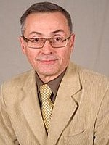
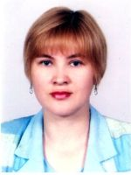
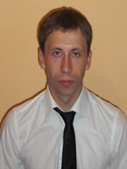
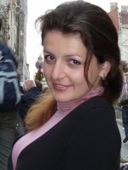
Local project team.
Zoia Duriagina
Eduard Pleshakov
Lidia Bohun
Vasyl Pidkova
Svitlana Olshevska

Slide 9
Contacts.
Lviv Polytechnic National University
Institute of Engineering Mechanics and Transport
Department of Applied Materials Science and Materials Engineering
Head of the AMSME Department,
Dc. of Scs., Prof.
Zoia Duriagina
Phone: +38 (067) 759-75-21
Home Tel.: +38 (032) 251-47-25
E-mail: zduriagina@ukr.net
Fax: +38 (032) 237-50-89
5 Ustyianovycha str., Lviv, 79013

