Slide 1

P12 –Magnitogorsk
State Technical University named after G.I. Nosov
Foundry and Materials Science Department
Alexey Korchunov

Slide 2

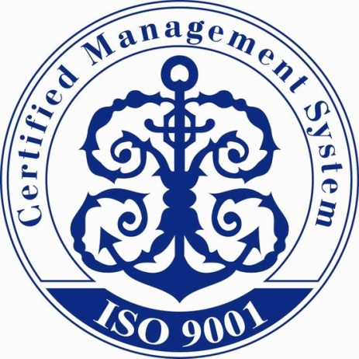
Magnitogorsk State Technical University named after G.I. Nosov: fact and figures
Founded in 1934 as Magnitogorsk Institute of Mining and Metallurgy
More than 15000 students
More than 1200 staff members
Work according to the principles of ISO and IQNET

Slide 3
Magnitogorsk State Technical University named after G.I. Nosov: fact and figures
Distribution:
5 Specialist's Degree
31 Bachelor's Degree
16 Master's Degree
27 Postgraduate Degree educational programs

Slide 4
University structure
2 Faculties
8 Institutes
2 Branches
Standardization, Chemistry and
Bioengineering Faculty
Metallurgy, Mechanical Engineering and Materials Processing
Office in Beloretsk
Mining Engineering and Transport
Multiple-Discipline College
Pre-University Education
Power Engineering and Automated Systems
Civil Engineering, Architecture and Arts
Economics and Management
Scientific research Institute of nanosteels
Extra-Mural Studies
Additional Vocational Education and HR Engineering

Slide 5
Faculty/department involved.
Metallurgy, Mechanical Engineering and Materials Processing Institute
Foundry and Materials Science Department
Mechanical and Metallurgical Process Engineering Department
Metal Forming Department

Slide 6
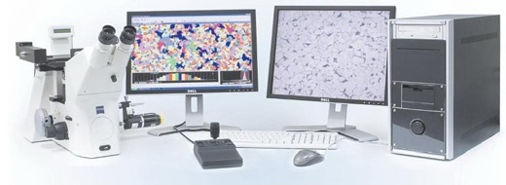
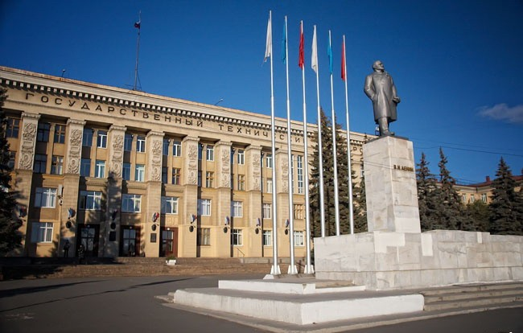
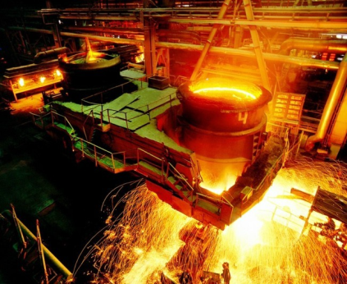
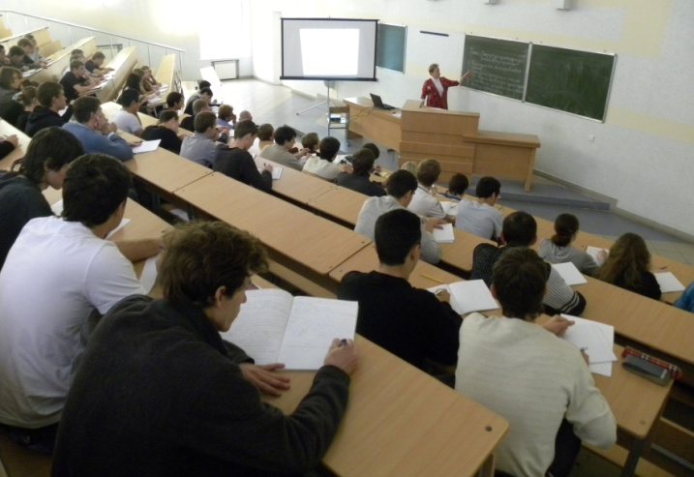
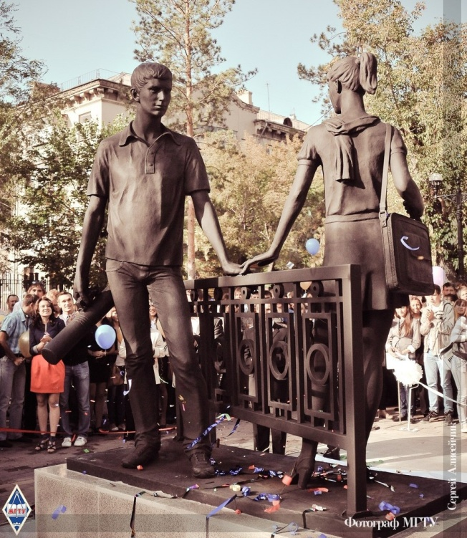
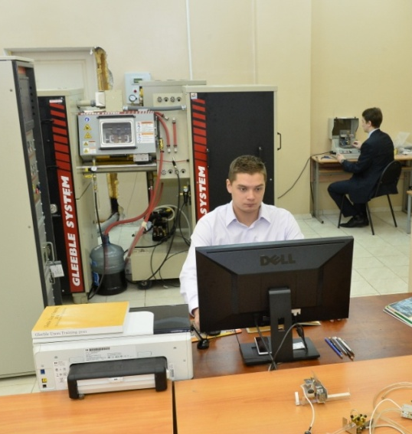
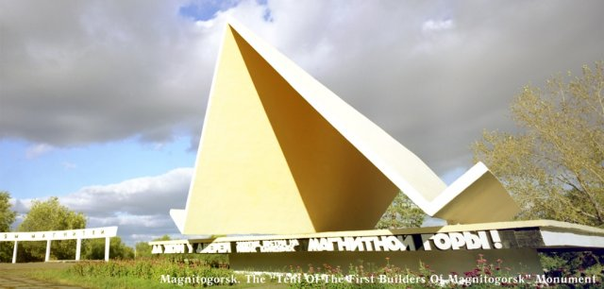

Slide 7









Stakeholders interested in the project outcomes/activities:

Slide 8
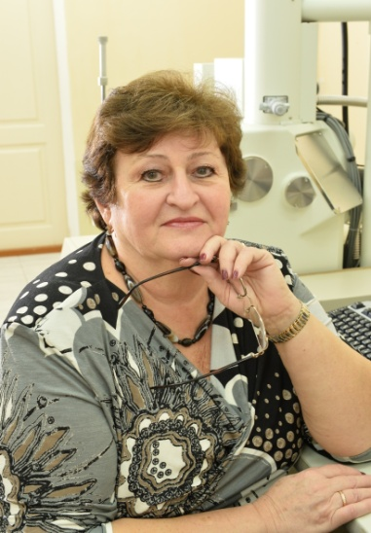
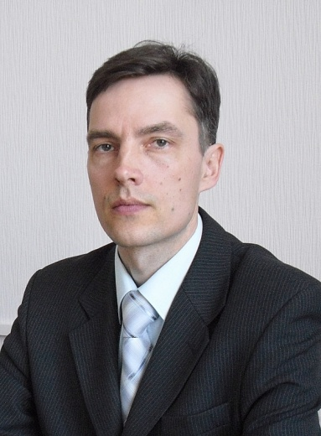
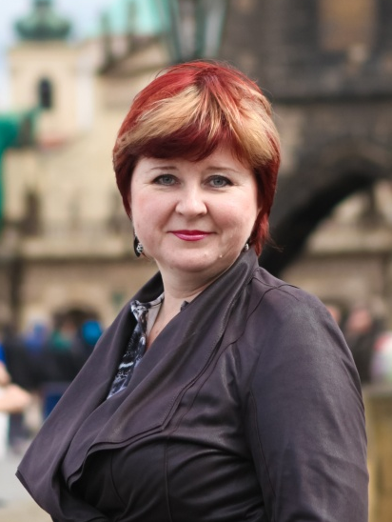
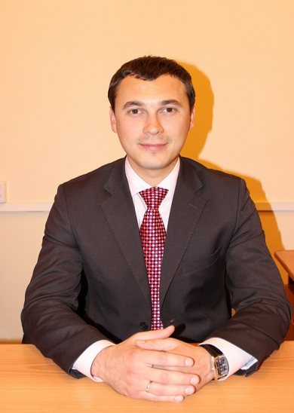
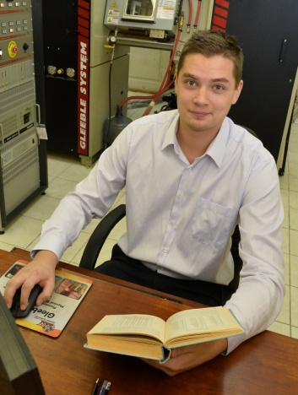
Local project team.
Natalia Koptseva
Alexey Korchunov
Marina Polyakova
Evgenii Shekunov
Dmitrii Chukin

Slide 9
Contacts.
Natalia Koptseva
Contact/ coordinator tempus MMATENG
Foundry and Materials Science Department
Lenin Street 38 , Magnitogorsk,
Chelyabinsk region, Russia,455000
Tel: +7 (3519)298567
mob.: +79090951861
E-mail: koptsev2002@mail.ru
Alexey Korchunov
Vice-Rector for International Affairs
Lenin Street 38 , Magnitogorsk,
Chelyabinsk region, Russia, 455000
Tel: +7 (3519) 298408
mob.: +79128094252
E-mail: international@mail.ru

