Slide 1

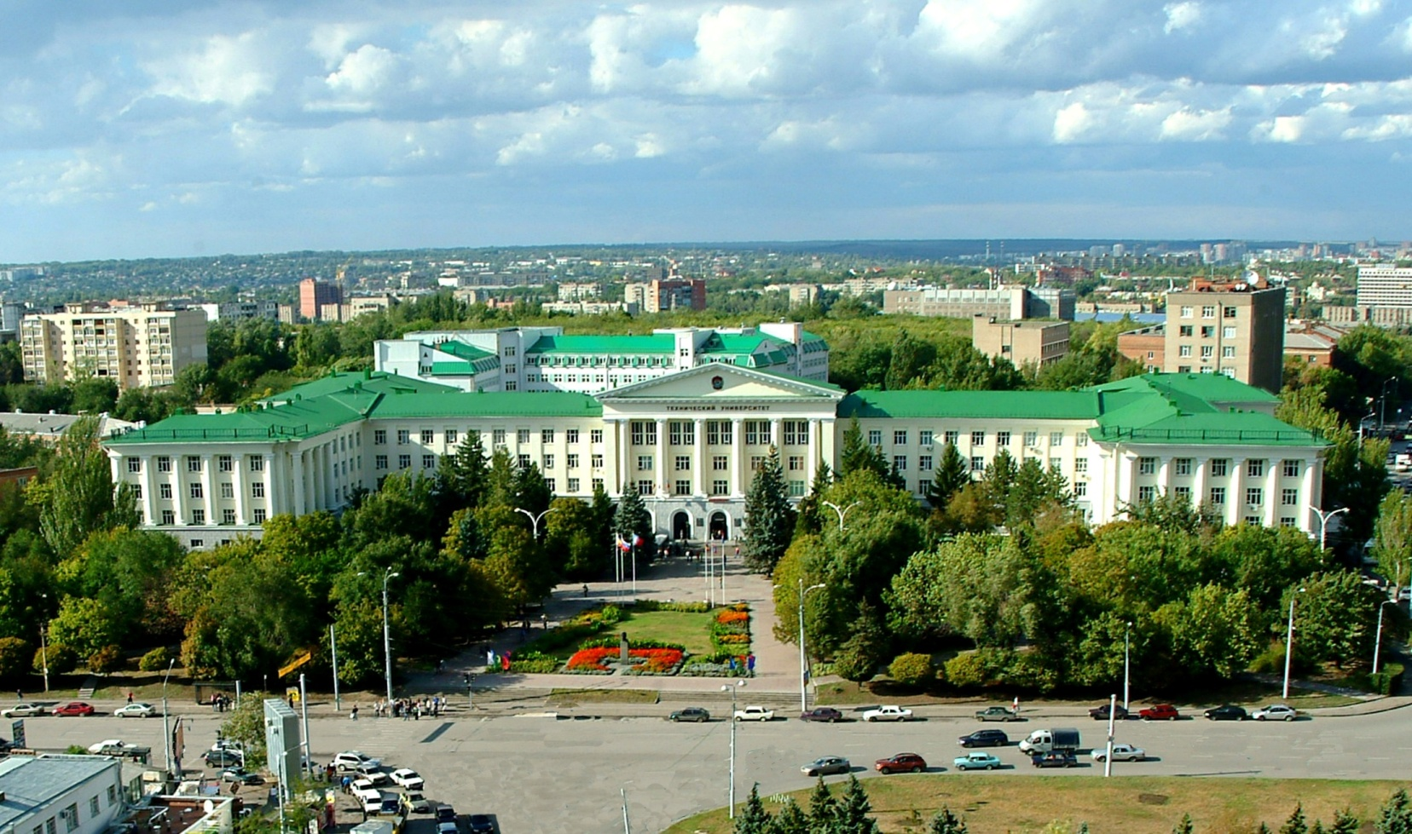
Don State Technical University
Alena Zheleva

Slide 2
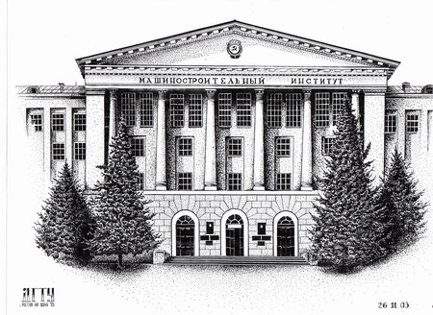
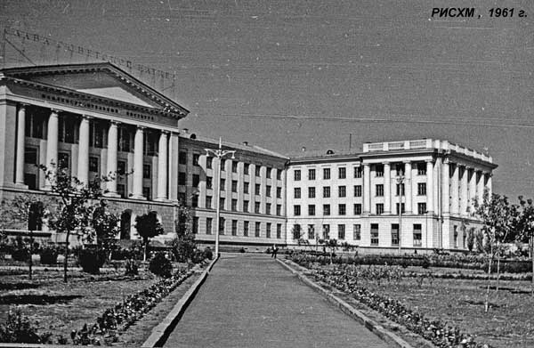
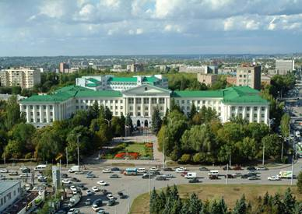
DSTU: fact and figures
dates back to 1930 when it was established as North-Caucasus Institute of Agricultural Machine-Building
1932-1992 - Rostov Institute of Agricultural Machine-Building, the leading educational and research technical institution of the USSR with 4 faculties and 25 specialties
1992 – a university status and the name of Don State Technical University
2013 – one of the biggest innovative educational and research center of lifelong learning with more than 45000 students and affiliations throughout South of Russia

Slide 3
The faculties of DSTU
Engineering
Computer Sciences
Humanities
Innovative Business and Management
Management and Entrepreneurship
Economy
Automation, Mechatronics and Control
Informatics and Computer Sciences
Humanities and Social Sciences
International
Mediacommunication
Physical Culture, Sport and Tourism
Mechanical Engineering Technologies and Machinery
Energy and Communication system
Life Safety and Environmental Engineering
Transportation, Service and Operation
Agricultural Machinery and Equipment
Aircraft Construction, Vehicle Service and Operation
Mechanical Engineering
Agro Engineering
Oil and Gas Industry

Slide 4
DSTU: fact and figures
PhD (3 years) | Engineering | Computer sciences | Economy | Humanities |  | 42 areas of research 97 patents 45 research labs and centers
Master (2 years) | Engineering (in a field) | Computer sciences | Economy (in a field) | Humanities (in a field) | Sport, Tourism and Service | 21 fields of study
Bachelor (4 years) | Engineering (in a profile) | Computer sciences | Economy (in a profile) | Humanities (in a profile) | Sport, Tourism and Service | 19 faculties 8 affiliated HEIs 60 fields of study
Secondary education | Technical lyceum, 4 Technical colleges (2 years) |  | College of Law and Economy | Gymnasium | Secondary school Cadet school | 9 educational institutions

Slide 5
Faculty/departments involved
Mechanical Engineering Technologies and Machinery
Construction Materials Engineering Department
Chemistry Department
Forming Technologies and Art Material Processing Department
Machines and Automation of Welding Production Department
Transport Engineering Department
Physical and Applied Material Engineering Department

Slide 6
DSTU: fact and figures
Bachelor Degree
1st | Foreign Language, History, Mathematics, Physics, Informatics, Chemistry, Psychology, Ecology, Information Technology, Philosophy | Practical training | 240 ESTS*
2nd | Foreign Language (Business Communication), Philosophy, Descriptive Geometry, Physical Chemistry, Metrology, Standardization, Certification, Crystallography and Crystal Structure Defects, Materials Structure Theory, Methods of Structural Analysis, Stereological Analysis, Electric Engineering, Composites Mechanics | Internship
3rd | Design and Mechanics of Composites, Economics, Non-equilibrium Thermodynamics, Material Properties, Thermo chemical Treatment, Theory of Diffusion Processes Business Administration, Materials Technology, Failure Mechanics, Non-destructive Inspection Technique, Heat Treatment of Metal, Patenting | Internship
4th | Material Properties Optimization, General Materials Sciences, Corrosion-resistant Covering, Concentrated Floorage Hard-facing, Chemistry of Nanomaterials, Material of Appliance and Medical Equipment, Environmental Engineering, Nanodiagnostics | Internship

Slide 7
DSTU: fact and figures
Master Degree
5th | Computer and Information Technologies in Science and Industry, Mathematical Modeling and Modern Materials and Processes Science Problems, Methods of Choice and Materials Design, Materials with Special Properties, Processes of Materials Technology, Modern Methods of Structural Study and Analysis, Foreign Language (Business Communication), Materials Science and Non-conventional Material Technology, Nanotechnology in Mechanical Engineering, Structure and Properties Materials Modeling, Metal Corrosion Protection, Laser Surface Hardening Theory and Technology and Surface Modification, Science and Technology Philosophy, Heat Treatment in Magnetic Field, Composite Materials | Industrial R&D Internship | 120 ESTS*
6th | Pedagogic and Teaching Principals, Plasma Surface Hardening Theory and Technology, Stereological Analysis of the Research, Materials Science Expertise, Specimen Preparation Technique, Education Legislative Environment. | Industrial R&D Internship
 |  | Teaching practicum
*1 ESTS = 36 “academic hours”

Slide 8
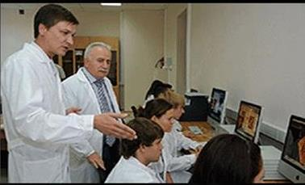

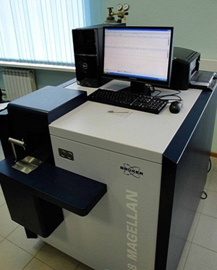
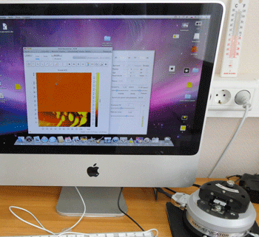
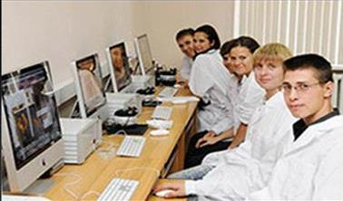
DSTU: fact and figures
Interdisciplinary resource center
Research works for graduates and post-graduates
cooperation

Slide 9
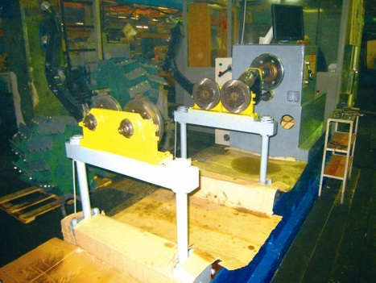
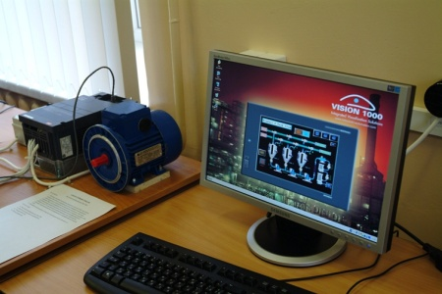
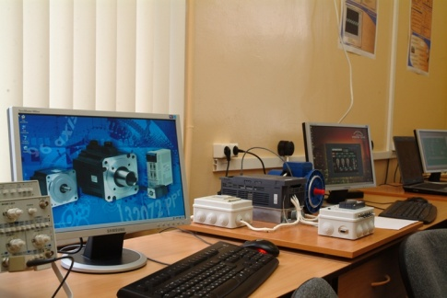
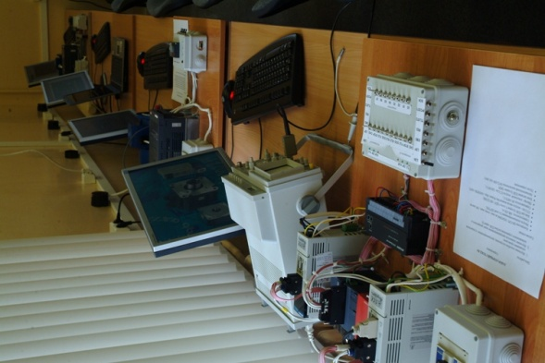

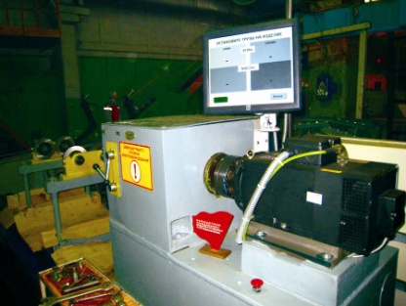
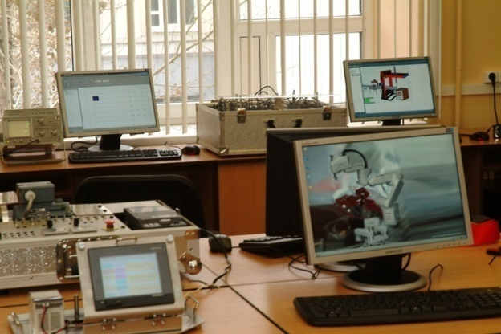
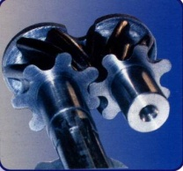
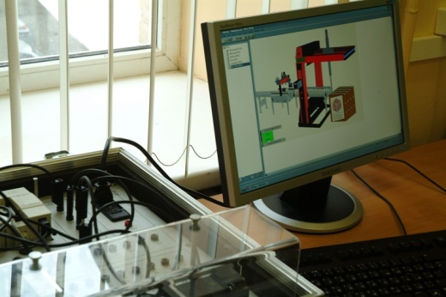
DSTU: fact and figures
Research laboratories
Laboratory of electron and probe microscopy
Microscopic metallography laboratory

Slide 10
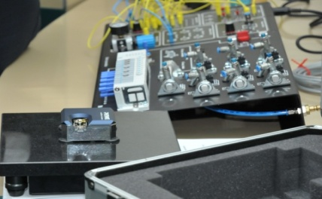
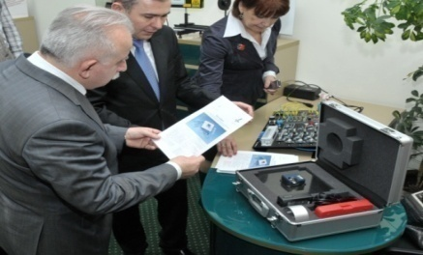
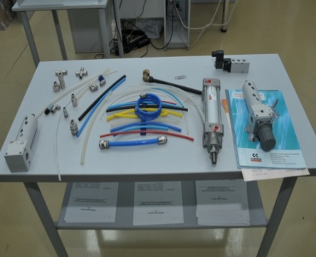
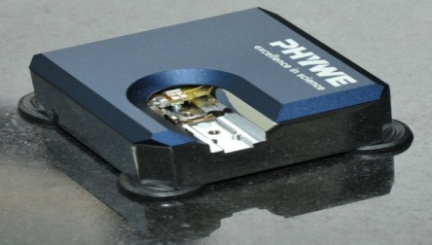

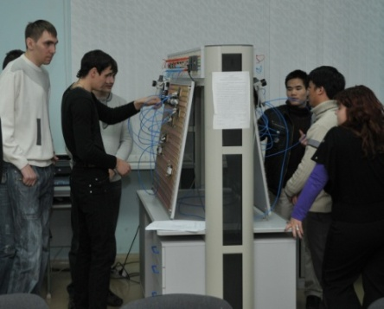
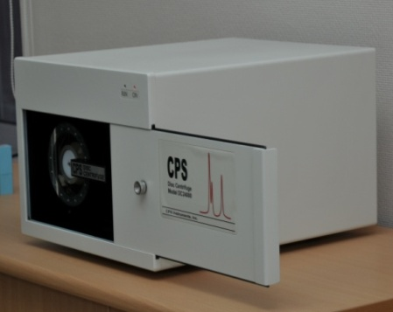

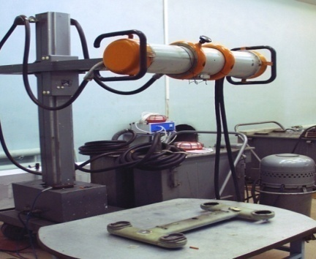
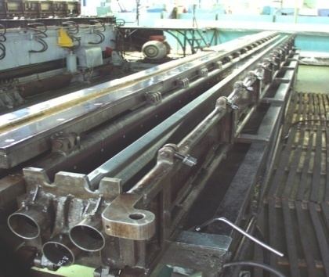

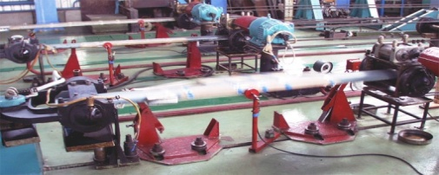
DSTU: fact and figures
In-company training
Info-centre for Atomic energy
PHYWE «NANO-CAB»
(Gettingem, Germany)
Rostov helicopter plant

Slide 11

DSTU: International projects
Tuning Russia
Project code - 511135-TEMPUS-1-2010-1-ES-TEMPUS-JPCR
Coordinator - University of Deusto, Spain
aims to meet the needs of educational institutions and structures and to offer a concrete approach to implement the Bologna Process at the level of higher education institutions and subject areas
proposes a methodology to (re-) design, develop, implement and evaluate study programmes for each of the higher education cycles in terms of competences and learning outcomes
Subject areas include Environmental Engineering, Information and Communication Technologies, Ecology

Slide 12
DSTU: International projects
1. E3M - Evaluation of Quality of Cooperation in Education Ecosystem as a Mechanism for Building Professional Competencies
Project code - 544028-TEMPUS-1-2013-1-FI-TEMPUS-JPHES
Coordinator - University of Applied Sciences JAMK, Finland
2. IQA - Independent Quality Assurance model for degree programmes in Russia
Project code - 530838-TEMPUS-1-2012-1-RU-TEMPUS-SMGR
Coordinator - Moscow State University of Geodesy and Cartography (MIIGAiK), RF
3. EQUASP - On-line Quality Assurance of Study Programmes
Project code- 543727-TEMPUS-1-2013-1-IT-TEMPUS-SMGR
Coordinator - University of Genoa, Italy
4. VALERU - Validation of non-formal/informal learning in Russian Higher Education
Project code - 544405-TEMPUS-1-2013-1-AT-TEMPUS-SMGR
Coordinator - Danube University Krems, Austria

Slide 13

DSTU: International сooperation
Assessment of Higher Education Learning Outcomes – OECD’s AHELO
aims to be direct evaluation of student performance at the global level and valid across diverse cultures, languages and different types of institutions
is based on collaboration between ministries, disciplines and technical experts, faculty and learners, institutional leaders, and a wide range of global stakeholders
Don State Technical University – in charge of the Engineering discipline specific skills assessment
NB - in the case of engineering the focus was made on the capacity of students to extrapolate from what they have learned and apply their competencies in new contexts, rather than replicate curriculum content knowledge

Slide 14

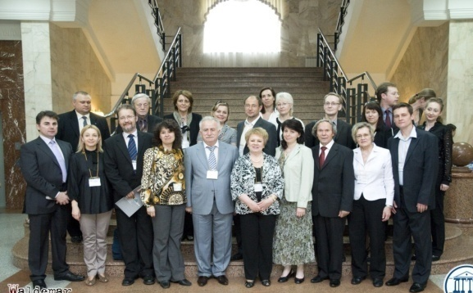
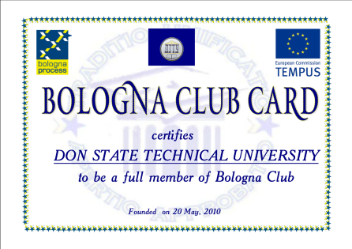
DSTU: International cooperation
Bologna Club RF
20 May 2010
open association of Russian Universities in charge of promoting Bologna Declaration principles and reforming Russian system of education
targeted to :
Bologna process tools implementation and best-practices sharing;
enhancing network cooperation and development of joint educational programmes;
internationalization of higher education;
institutional partnership promotion, etc.
http://bc.donstu.ru

Slide 15

DSTU: International cooperation
Sport/Social Academy for children and youth «DSTU - RealMadrid»
Sport as a tool for effective socialization and young people personal development support.
Social projects in 43 countries: Russian Federation is the 44-th country, Rostov region is the 61-st region.
Programs for children and youth: football and basketball sports schools.
Sports competitions and events.
Youth Summer Camps:
football and basketball trainings,
innovative educational program:
leadership
teamwork
tolerance
responsibility.

Slide 16







DSTU: Cooperation with international associations
Tuning World Academy
CDIO, International Association for Engineering Education
OECD, Organisation for Economic Cooperation and Development
AHELO, The Assessment of Higher Education Learning Outcomes
WorldSkills, Association for the Development of Vocational Education and Cooperation
IMPI-Flemish community, European Agency for the Internationalization of Higher Education
ASIIN, Agency for Accreditation of Degree Programmes in Engineering, Informatics, Mathematics and Natural Sciences

Slide 17












Stakeholders interested in the project outcomes/activities:
Novocherkassk locomotive plant
Bank Societe
Generale Vostok
Rostov combine-harvester plant
Taganrog vehicle manufacturer
Rostov helicopter plant
Phywe Systeme GmbH&Co
Azov optical-mechanical plant
Metal working enterprise
Energy company
Composition materials and biotechnologies
Media company
CNC for aviation

Slide 18
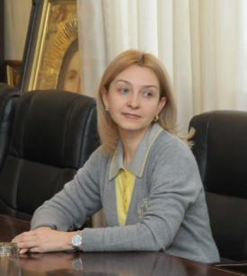
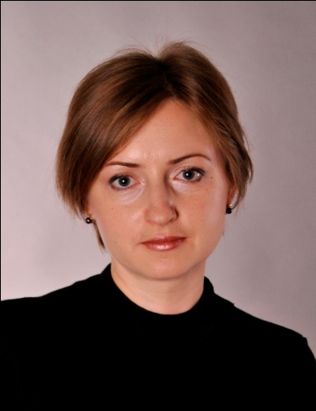
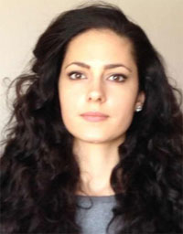
Local project team
Svetlana Shvedova
Elena Chernysheva
Vice-Rector on International Affairs, PhD,
associate professor.
Chief of the International Project Management Department, PhD
Alena Zheleva
Academic Mobility Expert, senior lecturer on Physical and Applied Material Science Department

Slide 19
Contacts
Svetlana Shvedova
Don State Technical University
Russia
Gagarin sq. 1
Rostov-on-Don, 344000, Russia
+7(863)2738-406
E-mail:dstu_oms@mail.ru
Elena Chernysheva
Don State Technical University
Russia
Gagarin sq. 1
Rostov-on-Don, 344000, Russia
+7(863)2738-744
E-mail:dstu_oms@mail.ru
Alena Zheleva
Don State TechnicalUniversity
Russia
Gagarin sq. 1
Rostov-on-Don, 344000, Russia
+7(863)2381-358
E-mail:dstu_oms@mail.ru

