Slide 1
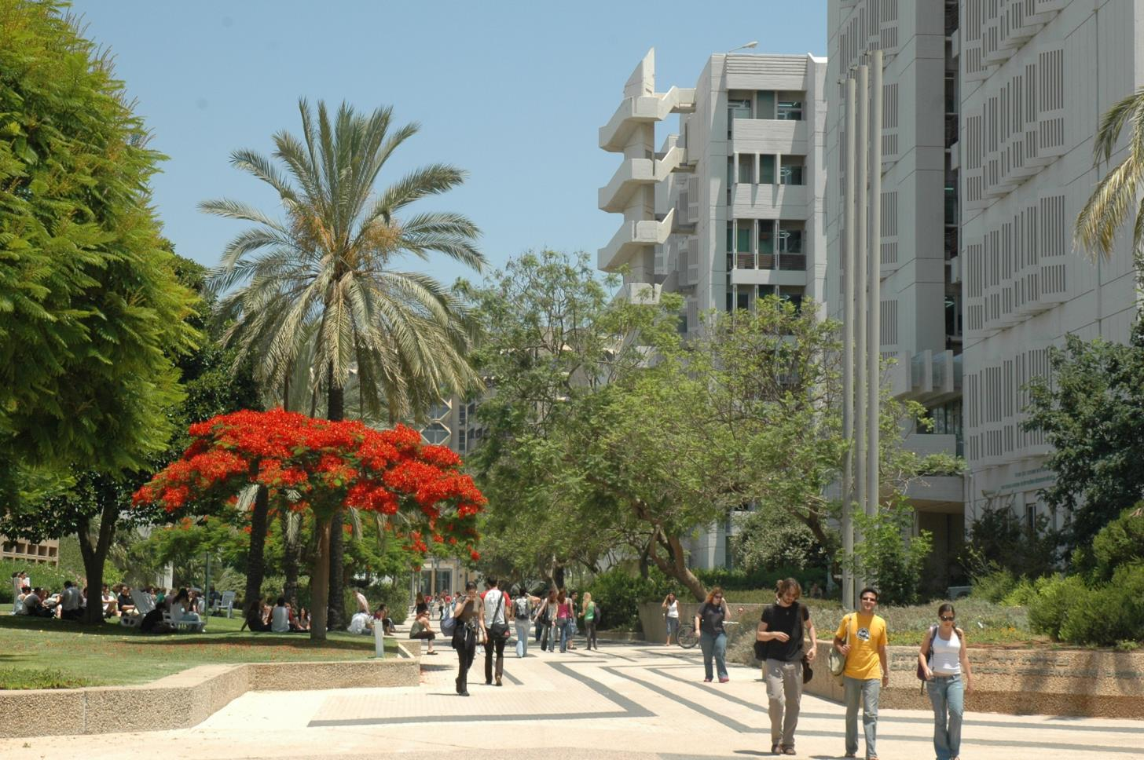

P7 – Tel Aviv University
Department of Materials Science and Engineering
Prof. Ilan Goldfarb

Slide 2

TAU: Facts and Figures
1956
established
1,032
academic faculty
30,000
students
9
faculties
100
departments
130
research centers
17
affiliated hospitals
210
chairs
6,600
acres

Slide 3
TAU structure
1956
established
30,000
students
Exact | Life | Medicine
Arts | Humanities | Engineering
Law | Management | Social
1,000
academic faculty
9
faculties
100
departments
130
research centers
17
affiliated hospitals
210
chairs
8,000
acres

Slide 4
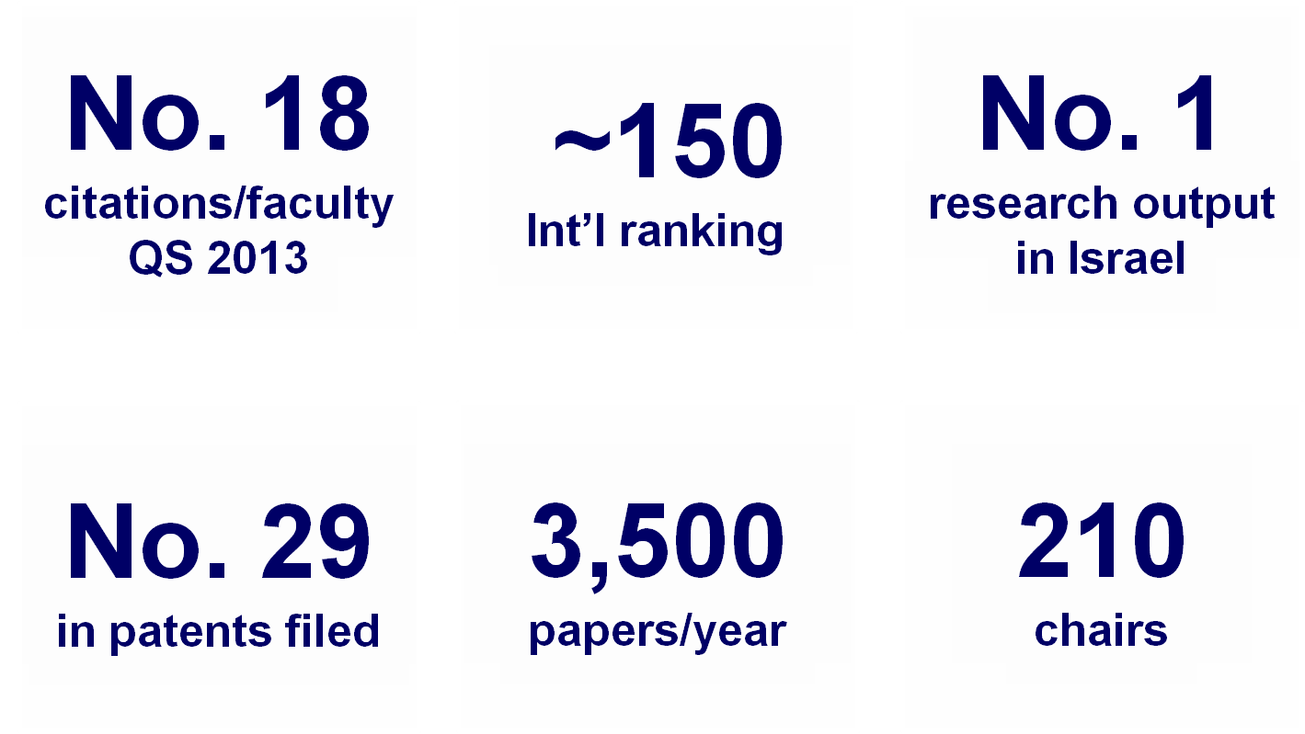
TAU: Academic standing
Shanghai 2012: #101-150
Times HE 2012: #158
Top ranking in many disciplines (Materials, Chemistry, CS, Nanosciences, etc.)

Slide 5


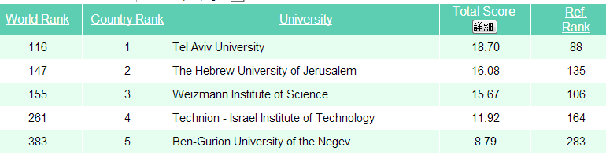
Taiwan Ranking 2012
Notes:
5

Slide 6

TAU International
1,200
int’l students
14
MA programs
2
BA/BSc. programs
1
MD program
400
study abroad students
60
origin countries

Slide 7
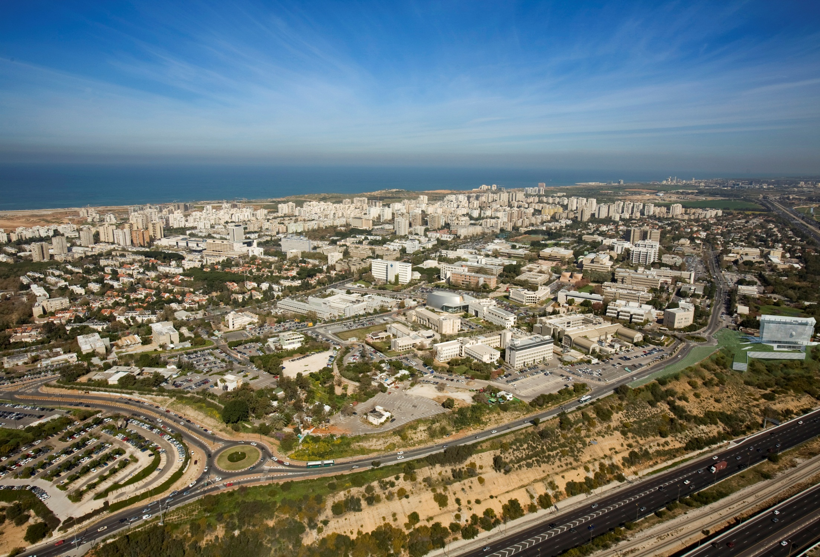

Areal view of TAU Campus
Science Promenade
Ayalon Highway
Train Station
Notes:
7

Slide 8

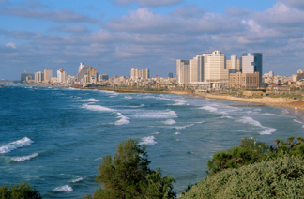

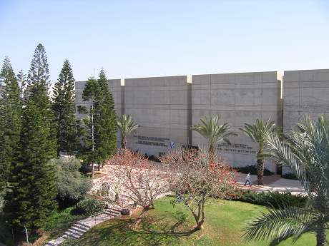
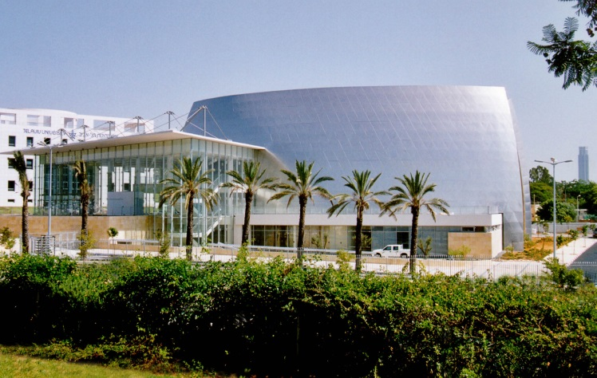
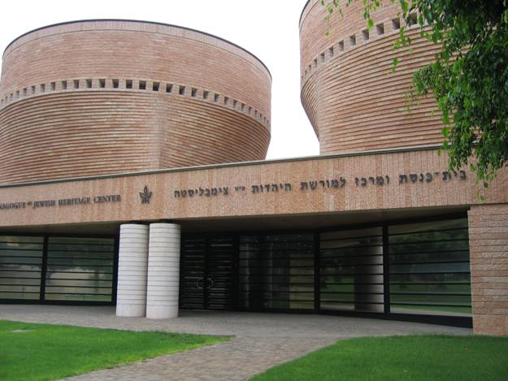
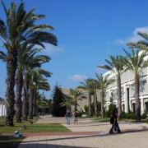
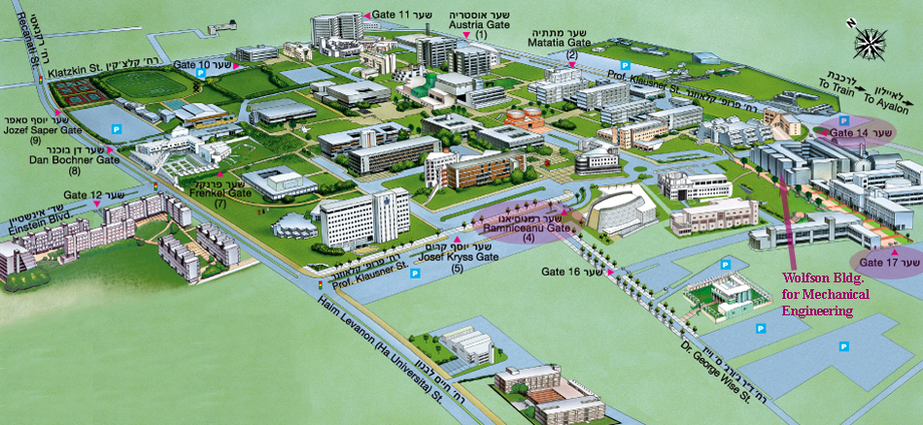
Tel Aviv University

Slide 9
Faculty/department involved.
Department of Materials Science and Engineering
Faculty of Engineering

Slide 10
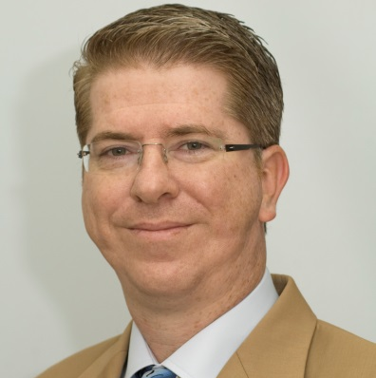
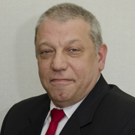
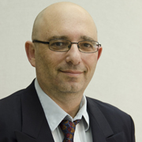
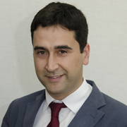
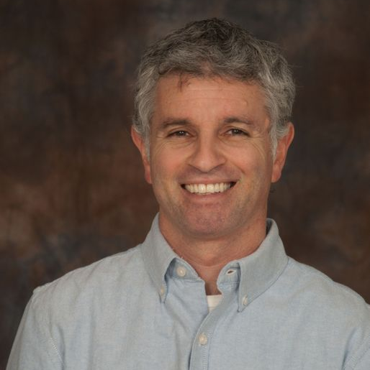
Local project team
Noam Eliaz
Ilan Goldfarb
Shachar Richter
Oswaldo Dieguez
Ariel Ismach

Slide 11
Contacts
Prof. Noam Eliaz
Chair, Department of Materials Science and Engineering
Tel Aviv University
Ramat Aviv, Tel Aviv 6997801
Israel
Tel: +972-3-640-7384
Fax: +972-3-640-6648
E-mail: neliaz@eng.tau.ac.il
Mr. Jack Barokas
Educational Digital Media Applications
Computing Division
Tel Aviv University
Ramat Aviv, Tel Aviv 6997801
Israel
Tel: +972-3-640-7848
Cell: +972-52-244-3288
E-mail: JackB@tauex.tau.ac.il

