Slide 1

P5 – Cracow University of Technology
Kinga Korniejenko

Slide 2
Cracow University of Technology: fact and figures
Founded in 1954
Approx. 18 000 students in 2013/14
More then 2 120 staff members
International cooperation:
  Lifelong Learning Programme (LLP)
  Bilateral agrement (38 countries in 2013)

Slide 3
Cracow University of Technology: fact and figures
Number of students
Total | 17 941
Full-time students | 13 929
Extramural students | 4 012
Doctoral candidates | 282
Postgraduate students | 836
Faculties | 7
Inter-facults units | 11
Courses of study | 25

Slide 4

University structure
7 Faculties
Other units
    Centre for Education and Organisation of Quality Maintenance Systems
    International Centre of Education
    Pedagogy and Psychology Centre
    Sports and Recreation Centre
    Library of the CUT

Slide 5
Faculty/department involved.
Faculty of Mechanical Engineering
  Institute of Applied Mechanics
  Institute of Materials Engineering
  Institute of Machine Design
  Institute of Automobiles and Internal Combustion Engines
  Institute of Thermal and Process Engineering
  Institute of Production Engineering
  Institute of Computing Science
  Institute of Rail Vehicles
  Institute of Industrial Apparatus and Power Engineering
  Laboratory for Coordinate Metrology

Slide 6
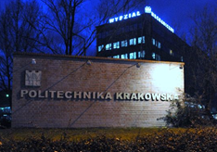
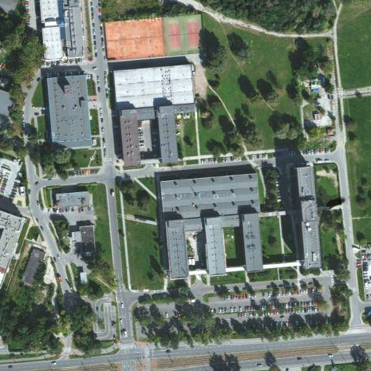
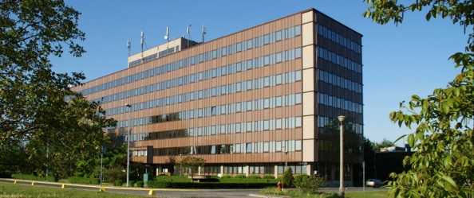
Cracow University of Technology: Faculty of Mechanical Engineering

Slide 7











Stakeholders interested in the project outcomes/activities:

Slide 8
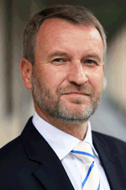
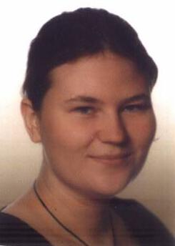
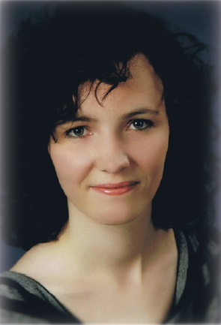
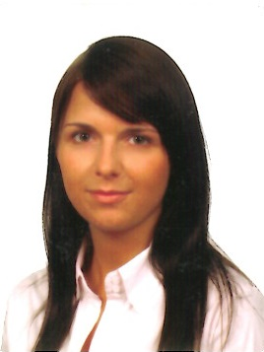
Local project team.
Janusz Mikuła
Kinga Korniejneko
Paulina Kuźniar
Katarzyna Lichwa

Slide 9
Contacts.
Prof Dr Eng Janusz Mikuła
Prof in material sciences
Head of the Institute of Material Science
CUT | Faculty of mechanical engineering
Jana Pawła II 37 street
Tel. + 48 (0) 628 34 13
mob. + 48 (0) 502 315 758
Email: jamikula@pk.edu.pl
Kinga Korniejenko
Administration officer in the Institute of Material Science
CUT | Faculty of mechanical engineering
Jana Pawła II 37 street
Tel. + 48 (0) 12 628 38 21
mob. + 48 (0) 609 97 49 88
Email: kinga@mech.pk.edu.pl

Slide 10
Contacts.
Paulina Kuźniar
Scientific Assisstant in the Institute of Material Science
CUT | Faculty of mechanical engineering
Jana Pawła II 37 street
Tel. + 48 (0) 12 628 34 64
mob. + 48 (0) 692 078 486
Email: pkuzniar@pk.edu.pl
Katarzyna Lichwa
Administration officer in the Institute of Material Science
CONTACT PERSON
CUT | Faculty of mechanical engineering
Jana Pawła II 37 street
Tel. + 48 (0) 12 628 38 21
mob. + 48 (0) 512 301 494
Email: klichwa@mech.pk.edu.pl

