Slide 1


Graduate School of Engineering Chemistry of Lille,
University of Lille, France
Jean-Bernard VOGT, Zahia TURPIN

Slide 2
ENSCL: fact and figures
Located on the campus of Lille University of Sciences and Technologies
Founded in 1894
Master’s degree
400 students
3500 alumni students
140 professors and assistant professors (40 from industry)
3 internationally recognized research laboratories

Slide 3
Education
PhD or JOB
5th year
Double degree program
Engineering program
Master’s degree
4th year
3rd year
National competitive entrance exam
2nd year
(preparatory classes)
1st year
(preparatory classes)
Selection on academic records
End of secondary school

Slide 4
Core syllabus:
chemistry : science and technology
Personalized syllabus:
science and technology
Semester 5
Semester 6
Semester 7
Semester 8
Semester 9
Semester 10
YEAR 3
YEAR 4
YEAR 5
Solid state chemistry -Mineral chemistry
Catalysis - Chemical engineering
Polymer chemistry - Materials science
Design and synthesis of materials or compounds with defined properties
…
Materials
SPECIALITY
Optimization and Reliability of Engineering Materials
Department involved :
UMET : Laboratory of Materials : Team Physical Metallurgy and Engineering Materials
3 Mandatory placements in industry (at least 10 months)

Slide 5
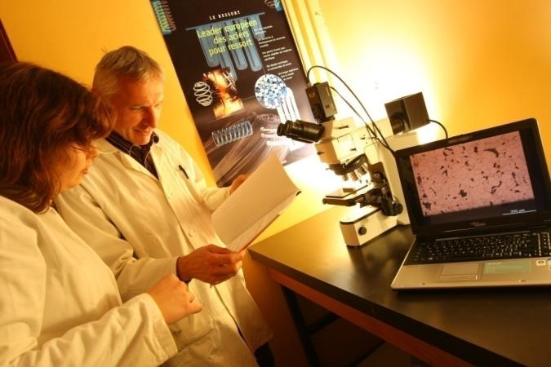
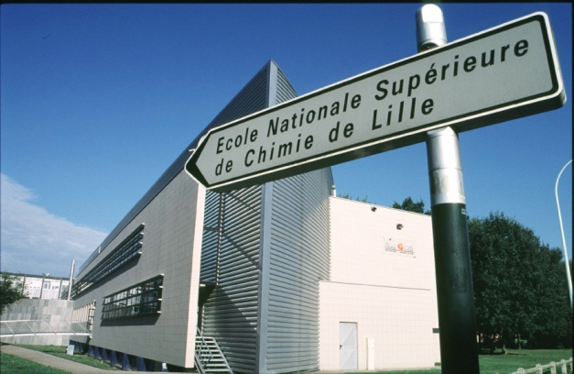
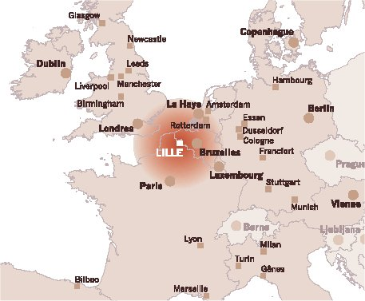
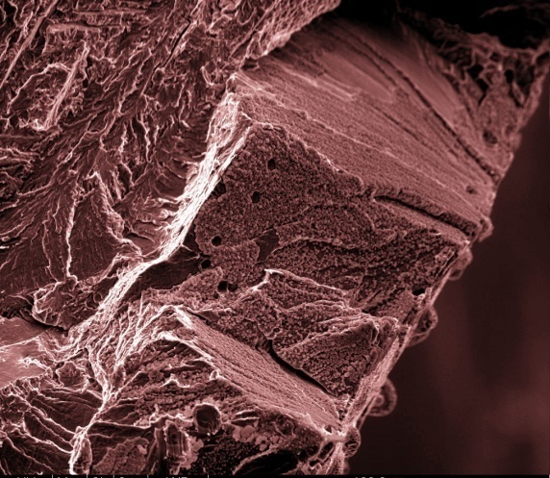
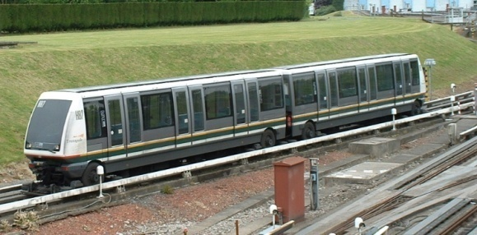
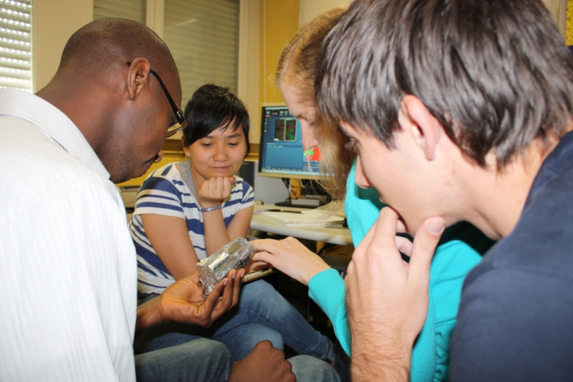
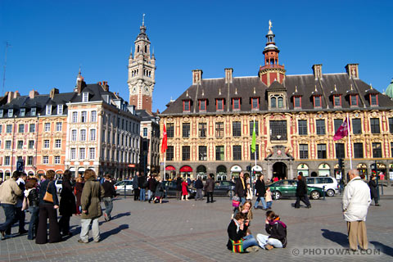
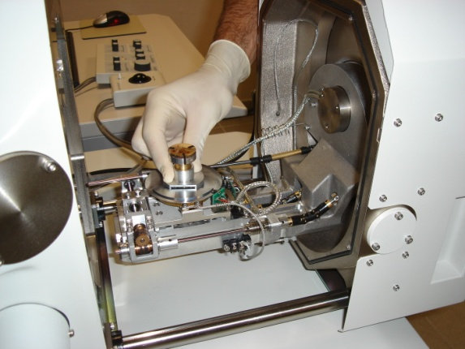
Lille

Slide 6











Stakeholders interested in the project outcomes/activities:

Slide 7
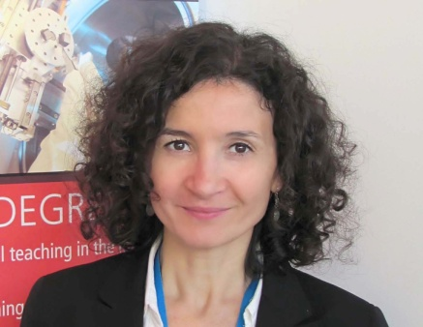
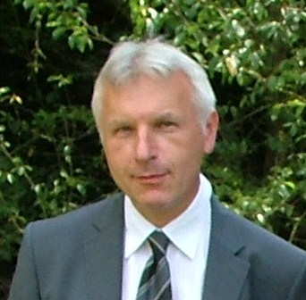
Local project team
Zahia Turpin
Jean-Bernard Vogt

Slide 8
Contacts :
Jean-Bernard VOGT
Professor at ENSCL
Fatigue, environmental effects
Université Lille 1 Sciences et Technologies
Unité Matériaux Et Transformations (UMET)
Team Physical Metallurgy and Engineering Materials UMR CNRS 8207
Bâtiment C6
59655 Villeneuve d'Ascq Cedex – France
Phone: +33 3 20 43 40 35
Email : jean-bernard.vogt@ensc-lille.fr
Jérémie BOUQUEREL
Assistant Professor at ENSCL
Microstructure investigation, metallurgy
Université Lille 1 Sciences et Technologies
Unité Matériaux Et Transformations (UMET)
Team Physical Metallurgy and Engineering Materials
UMR CNRS 8207
Bâtiment C6
59655 Villeneuve d'Ascq Cedex – France
Phone: +33 3 20 43 42 29
Email : jbouquerel@ensc-lille.fr
Zahia TURPIN
Director of International Relations
ENSCL Cité scienfitique
59652 - Villeneuve d'ascq cedex, France
Phone : +33 3 20 33 71 35
Email : zahia.turpin@ensc-lille.fr

