Slide 1

Technische Universitaet Berlin
Elena Eyngorn
Ruslan Muydinov

Slide 2
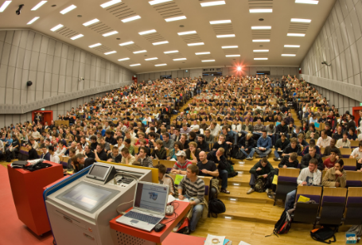
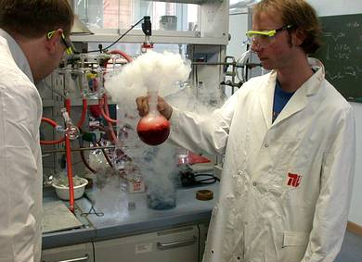
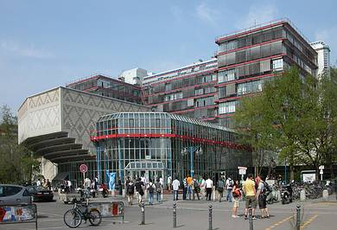
Facts and Figures
Students 32.000
  female 10.300
  international 6.000
Faculties (Schools) 7
Degree programs 109
Professors 400
Scientific staff 2.364
Other Staff 4.402
PhD/year 460
Budget:
From government 280 Mio. €
Additional (third party) funds 170 Mio. €
Notes:
2

Slide 3
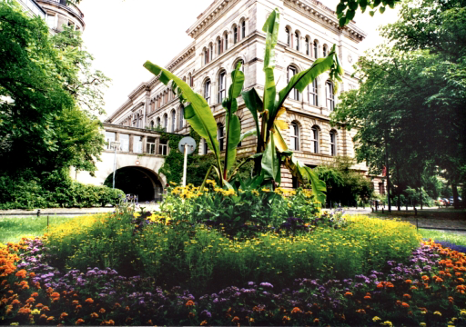
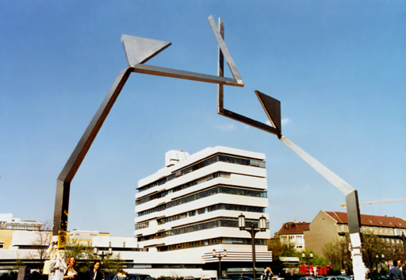
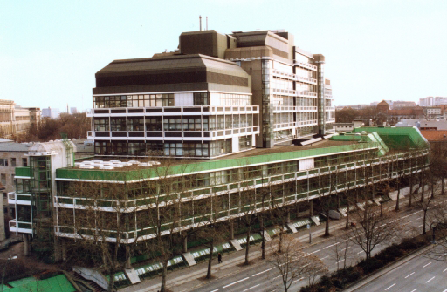
Faculties and Institutes
Faculty | Name | Institutes
I | Humanities | 7
II | Mathematics and Natural Sciences | 6
III | Process Sciences | 6
IV | Electrical Engineering and Computer Sciences | 6
V | Mechanical Engineering and Transport Systems | 7
VI | Planning – Building - Environment | 8
VII | Economics and Management | 3

Slide 4
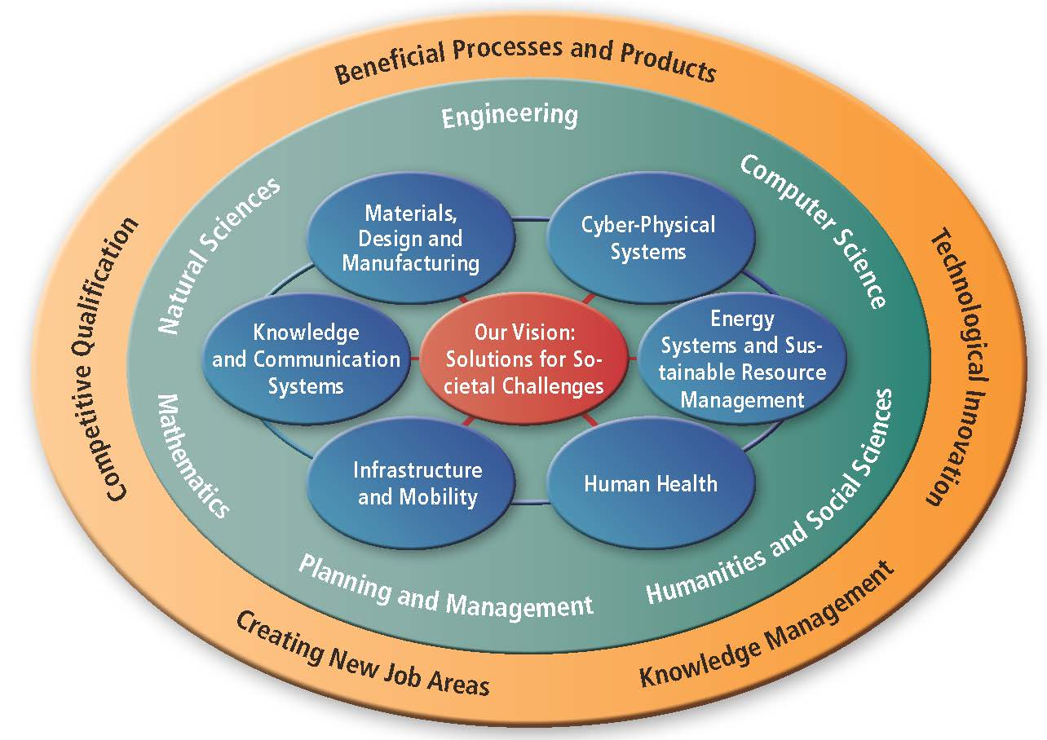
Strategic research topics
TU Berlin
4

Slide 5
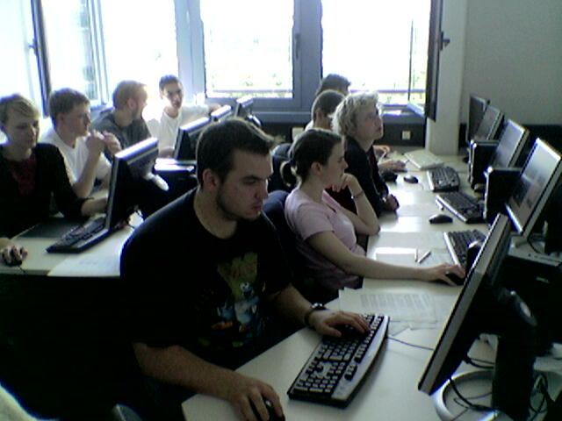
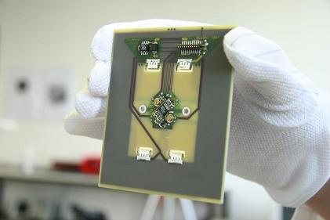
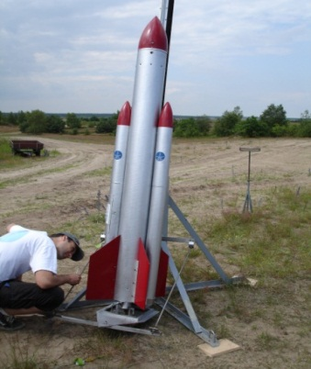
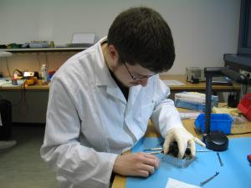
4 Main Points at Chair of Space Technology
Curricula in Space Technology
Space Technology Research
Theoretical and Hands-on
Education in Satellite Technology
Theoretical and Hands-on
Education in Rocket Technology

Slide 6
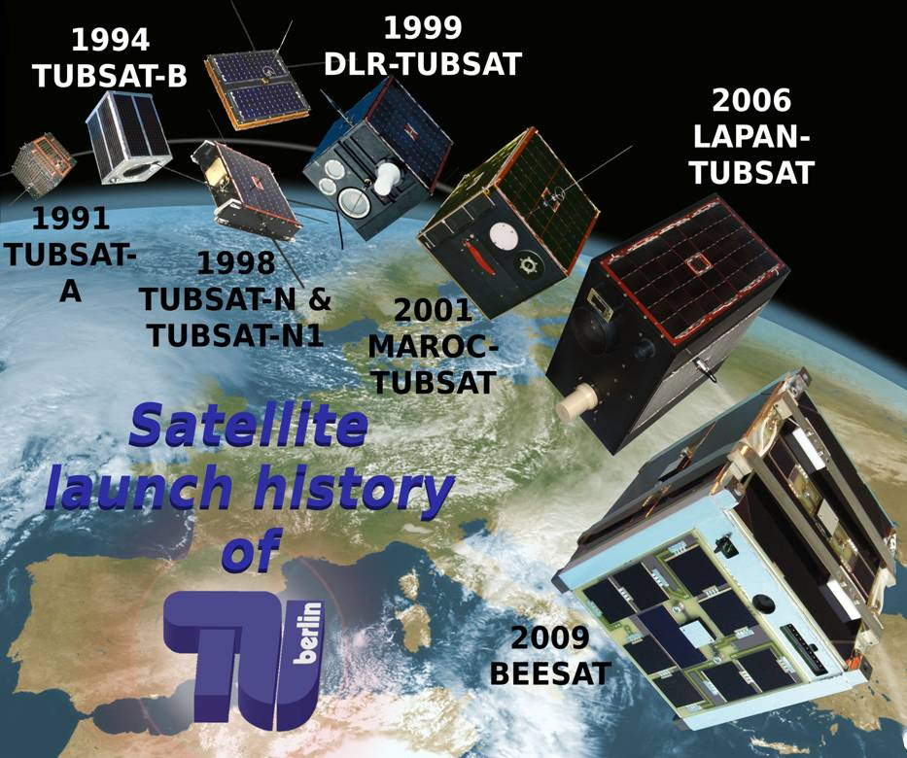
BEESAT-2,-3. April 2013
in preparation
2014 | TUBIN | 20 kg
2014 | BEESAT-4 | 1 kg
2015 | TECHNOSAT | 15 kg
2015 | S-NET | 4 X 10 kg
University: images

Slide 7
A typical curriculum:
Profile of our programs
Compulsory
(Foundation)
Bachelor thesis
Electives
(Specialization)
Master thesis
Free choice
Soft skills
Bachelor
Master

Slide 8
Introduction to Module
Soft Skills for Engineers
-Effective communication with groups: 2 ECTS, 40 hours
-Survival in Labor Market: 2 ECTS, 40 hours
Professional development programs support Ph.D students in:
    research integrity
    teaching skills
    research paper writing and presentation skills
    innovation and technology entrepreneurship
    communication and leadership
    presentation techniques
    Engineering students:
    engineering ethics
    technology entrepreneurial skills
    communication and teamwork
    management

Slide 9
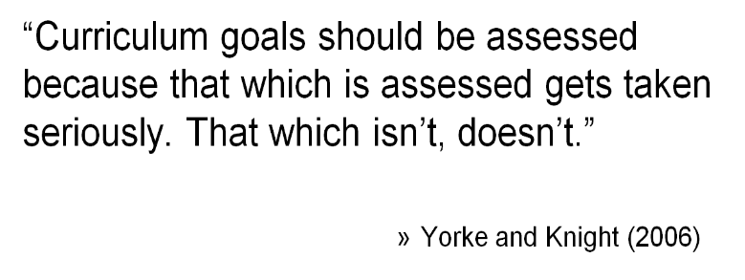
How to prepare scholars and high quality professionals for diversified career paths?
Research-oriented
Master’s students
40% in academic programs
Career-oriented
Doctoral students
58% in Ph.D. programs
9

Slide 10
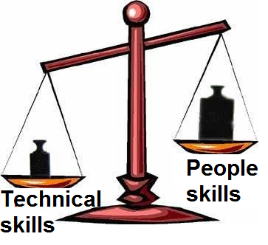
A new Culture of Learning & Teaching
From transmission of knowledge to learning how to learn
From over-emphasizing academic studies to focusing on whole-person
From compartmentalized subjects to integrated learning
From reliance on textbooks to use of diversified teaching materials: e-tools
From premature streaming to providing more opportunities for students to explore their aptitudes and potentials

Slide 11
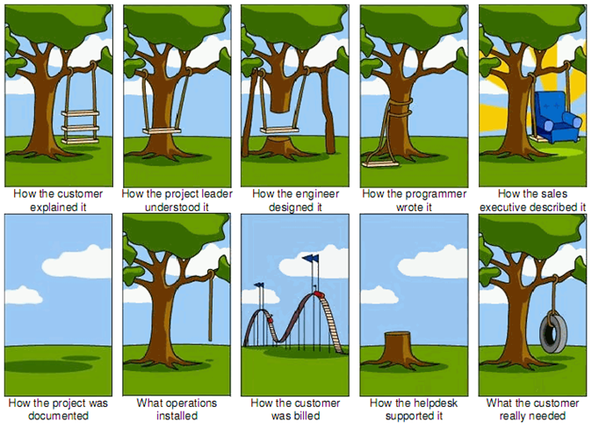
What are soft skills?
Notes:
The importance of the Soft Skills emerges from the demand by employers looking into cooperation between technical and non-technical skills in the individuals which facilitate interaction with others.

Slide 12
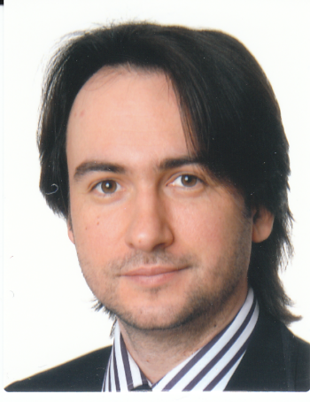
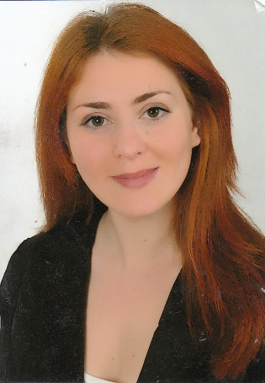
Local project team.
Dmitry Ostroverkhov
Elena Eyngorn
Ruslan Muydinov

Slide 13

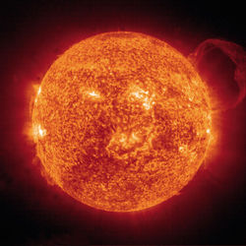
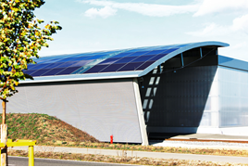
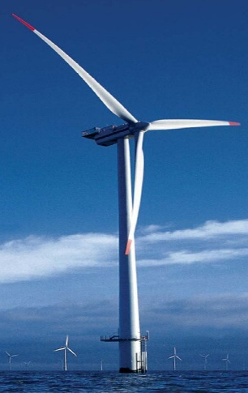
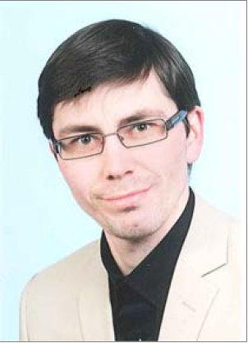
Thin Films in Energy-Efficient Technologies
Тонкие пленки в энергосберегающих технологиях.
45 contact hours + 30 hours student workload
∼22 lectures + ∼10 practicums
3 ECTS
Dr. Ruslan Muydinov
к.х.н. Руслан Муйдинов
(специальность «Материаловедение»,
МГУ, Химический Факультет)
ruslan.muydinov@tu-berlin.de
Tel. 030 31422909, Fax. 030 31424626
2006 – PhD (MSU)
2007-2008 – PostDoc at Institute for
Surface Technology (IOT, TU Braunschweig)
2009-2012 – Project Manager at
PerCoTech AG (TU Braunschweig)
2012- … Senior Scientist at Department of
Thin Film Devices (HFT, TU-Berlin)

Slide 14
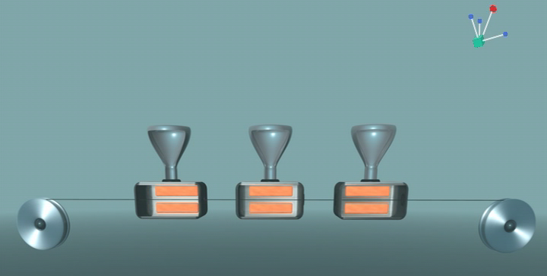
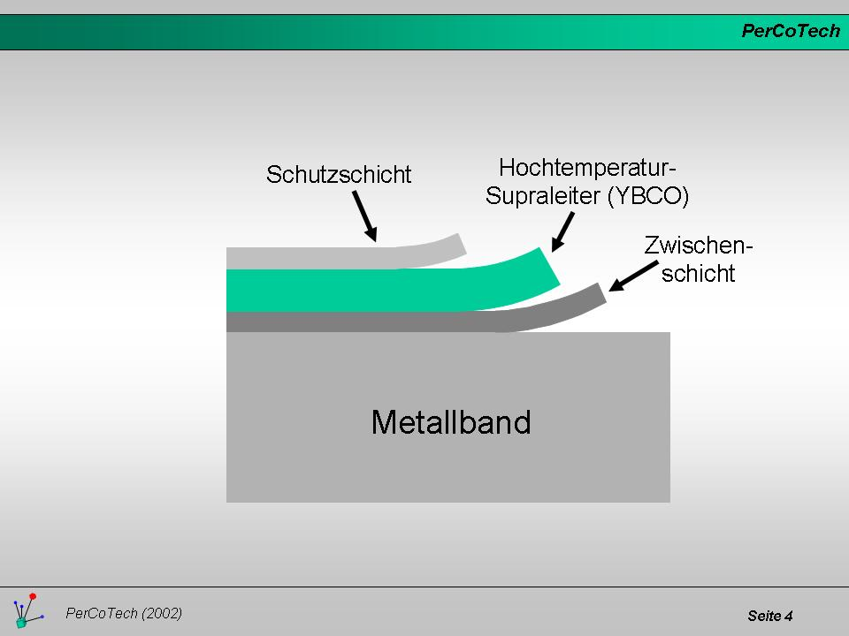
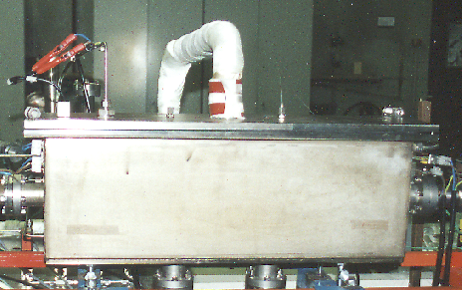

My experience: MOCVD + HTS (2nd Gen. Wires)
IOT, PerCoTech AG, TU Braunschweig
in-line Multilayer-CVD at PerCoTech
Structure of HTS-wire Wire
Heating
Lines
Precursor vapours to the reactor
Ag – cap layer
HTS-Film
Buffer-
layers
Precursor
Evaporation
MFC
RABiTs
MFC
Solvent
Separation
Solvent
condensation
Analytics:
XRD, SEM/EDX, XPS,
inductive measurements of
T_{c} & j_{c} (CRYOSCAN),
direct I_{c} measurements
MFC
Solution Feeding
R. Muydinov: Thin Films in Energy efficient technologies

Slide 15
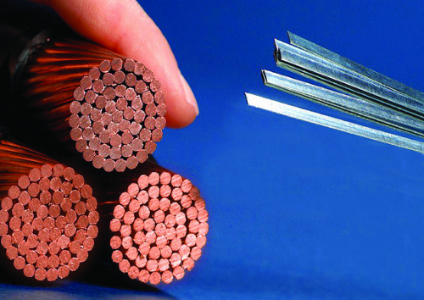
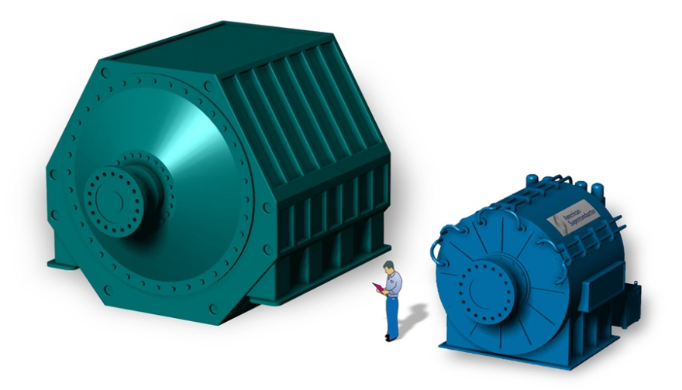
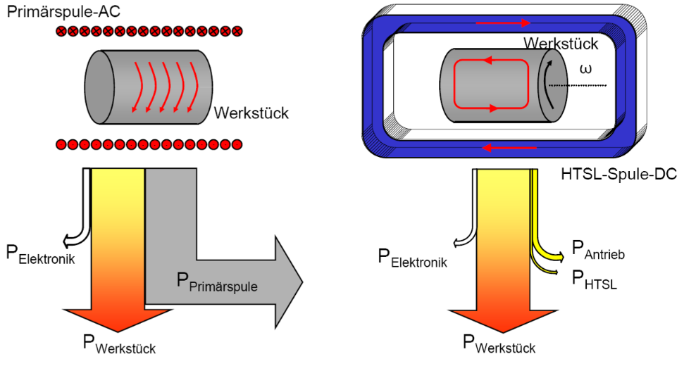
Superconductive Wires
Generators / Energy losses
Wires /
Energy density
100-500
A/mm²
-50%
1-5 A/mm²
Inductive heater
-50%
Engines /
Size-weight
36,5 MW Ship engine (American Superconductor)
-50%
R. Muydinov: Thin Films in Energy efficient technologies

Slide 16
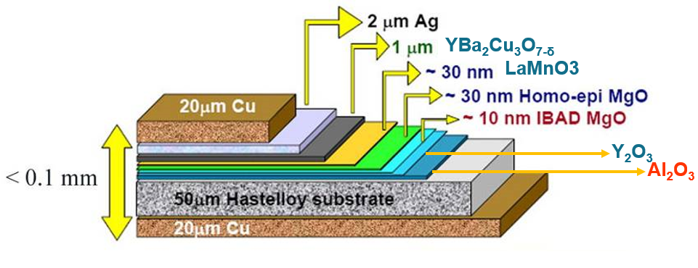
Curriculum:
Content and Context
Thin Films in Superconductivity
6₂₂ Lectures / 3₁₀ Practicum
Effect of Superconductivity (Hystory, Effects, Materials). 2 lectures
HTS-Wires and thin film technologies. 2 lectures
Applications of HTS-wires (generators, motors,
cables, FCLs, magnets). Economical aspect. 2 lectures
Observation of levitation-effect on ceramic YBCO-sample over the magnets.
Freezing of magnetic fluxes in superconductor. Small seminar (effects).
2-3. XRD measurements on epitaxial YBCO-films. Determination of in-plane
and out-of-plane textures. Determination of epitaxial and polycrystalline
fractions of a film.
R. Muydinov: Thin Films in Energy efficient technologies

Slide 17
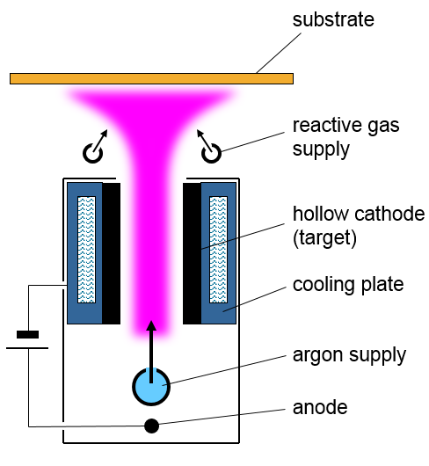
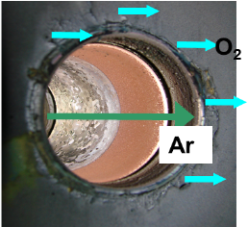
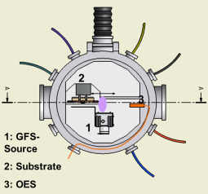
My experience: PVD (GFS, DC/RF-MS) + TCOs
HFT, TFD, TU-Berlin
Hollow Cathode Gas-Flow-Sputtering
Analytics:
UV-Vis, Ellipsometry, Profilometry,
Conductivity/Hall-Effect meas.,
overall and quantum efficiency
measurements, optical properties
modelling
Sputtering of conductive ring segments
Chemically active zone
Remote process, no arcing due to purge gas
Dense plasma / low energy, mbar, high rate
Scalable system up to
1 m offered by FhG-IST
Control by OES and / or pressure (1..10 mbar)
More than 20 units installed
T. Jung et al., Surf. Coat. Technol. 86-87 (1996) 218 |B. Szyszka et al., Thin Solid Films 518 (2010) 3109
R. Muydinov: Thin Films in Energy efficient technologies

Slide 18
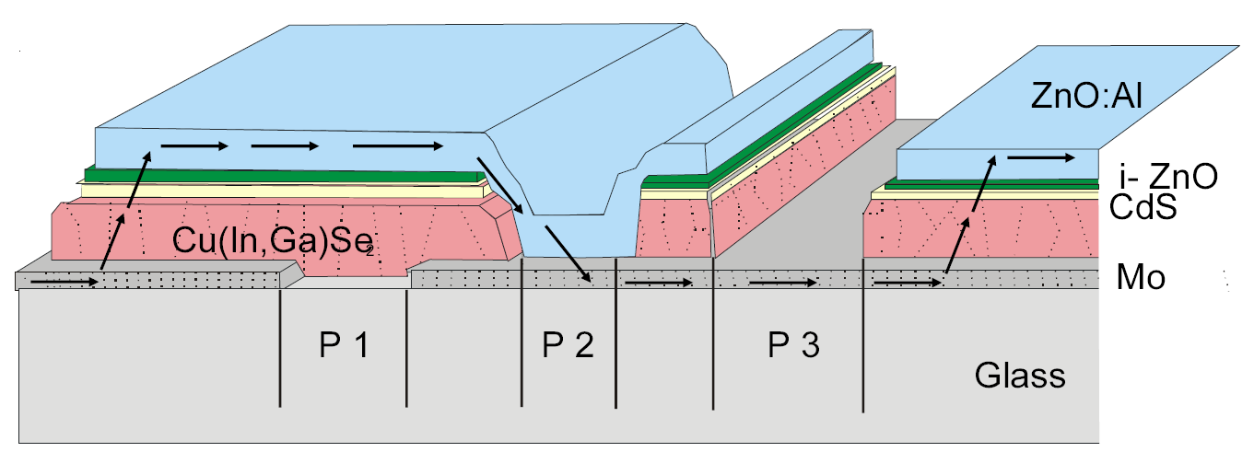
Curriculum: Content and Context
Thin Films in Photovoltaic
8₂₂ Lectures / 4₁₀ Practicum (devoted to TCOs)
Photovoltaic (economical motivation, principles,
problems, approaches). 2 lectures
Si-thin film’ photovoltaic (materials, technological
features, restrictions). 2 lectures
3. CIGS-thin film’ photovoltaic (materials, technological
features, restrictions). 2 lectures
4. New approaches in thin film’ photovoltaic (OPV,
flexible photovoltaic, perovskite-ETAbsorber etc.). 2 lectures
1-2. UV-Vis measurements (TT/RT/absorption, diffuse vs. specular reflection,
angular resolved measurements, haze determination).
3-4. Ellipsometric measurements. Conjugated fitting with UV-Vis data so to get
μ, N_{e}, refractive index, film thickness and model description of layers. Hall-
effect- and 4-point conductivity measurements to approve a fitting model.
R. Muydinov: Thin Films in Energy efficient technologies

Slide 19
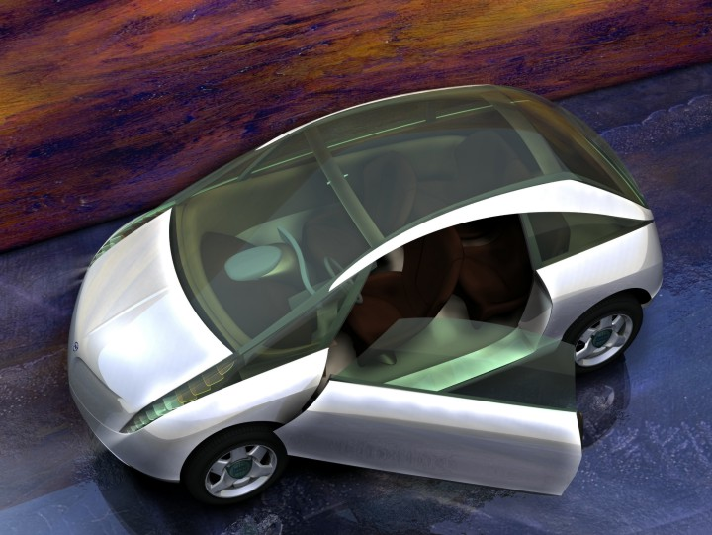
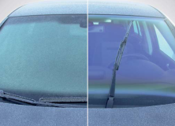
TCOs – broad application.
2. Self healing, heatable
Anti-Reflex Low-E Films
3. Switchable Anti-sun und
Privacy-glazing
4. Active Noise-supressing
Glas with integrated
Lightsource
1. TCO on CIS PV foil
integrated auto-
photovoltaic
5. Low-E covered
complex 3D-
Polymer glazing
6. Hydrophilic,
antibacterial Head-Up
Display glass
7. Top emitting AM OLED Displays
with Touch-surface
8. Arrays from Oxide-based Gas-sensors
for energy-efficient use of climate control
10. Engine-control via
Oxide-Electronics, RtR
9. High-energy–LEDs with
TCO Front Contact and lossless Mirrors
R. Muydinov: Thin Films in Energy efficient technologies

Slide 20
Curriculum: Content and Context
Thin Functional Films – Creation of Properties
8₂₂ Lectures / 3₁₀ Practicum
Deposition techniques (PVD, PLD, CVD, PECVD,
ALD, spin-coating, dip-coating)
and growth mechanisms. 3 lectures
2. Analytical methods devoted to structure,
microstructure and composition of thin films (XRD-
stresses’ analysis, mechanical properties, EBSD,
SEM, AFM, EDX, EPMA, XPS). 3 lectures
Examples of multilayer systems (low-E, mechanically
stable, epitaxial films’ stacks). 2 lectures
1-2. Determination of a film thickness (profilometry, SEM).
XRD measurements: determination of stresses in a crystalline film.
R. Muydinov: Thin Films in Energy efficient technologies

Slide 21
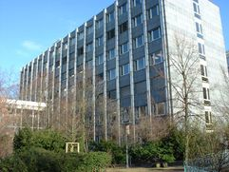
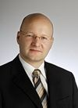
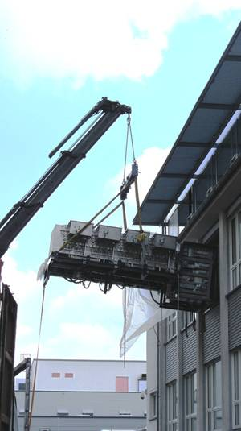
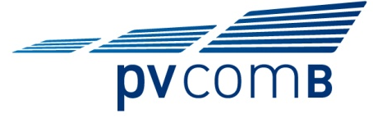




Our team at TU Berlin
Fakultät IV: Elektrotechnik und Informatik
HFT: Institut für Hochfrequenz und Halbleiter-system Technologien
TFD: Thin Film Devices
Prof. B. Szyszka
1 PostDoc, 1 PhD, 1 Master-student,
1 engineer, 1 workman, 1 Secretary…
R. Muydinov: Thin Films in Energy efficient technologies

